Slide 1
ASMITHA SHANI MICHAEL
Final Project
3/21/2024 Annual Review

Slide 2
PROJECT TITLE
STOCK PRICE PREDICTION USING CONVOLUTIONAL NEURAL NETWORK (CNN)
3/21/2024 Annual Review

Slide 3


AGENDA
PROBLEM STATEMENT PROJECT OVERVIEW WHO ARE THE END USERS? YOUR SOLUTION AND ITS VALUE PROPOSITION THE WOW IN YOUR SOLUTION MODELLING RESULTS
3/21/2024 Annual Review

Slide 4

PROBLEM STATEMENT
The goal of this project is to develop a CNN-based model capable of accurately predicting future stock prices based on historical price data and relevant market indicators. The model should be trained on a dataset consisting of historical stock prices, volume, and possibly other financial indicators, and evaluated on its ability to forecast future price movements over a specified time horizon. The aim is to create a robust and reliable predictive model that can assist investors and traders in making informed decisions in the financial markets.
3/21/2024 Annual Review

Slide 5

PROJECT OVERVIEW
This project focuses on developing a Convolutional Neural Network (CNN) model for predicting stock prices based on historical market data. It involves collecting historical stock data, preprocessing it, designing a CNN architecture, training the model, evaluating its performance, and deploying it for real-time predictions. The goal is to create an accurate and reliable tool to assist investors in making informed decisions in the financial markets.
3/21/2024 Annual Review

Slide 6

WHO ARE THE END USERS?
Individual Investors: Retail investors looking to make informed decisions about buying, selling, or holding stocks. Financial Institutions: Banks, hedge funds, and other financial institutions seeking to optimize their investment strategies and manage risk. Algorithmic Traders: Traders employing automated trading systems that utilize machine learning models for decision-making. Investment Professionals: Financial advisors, portfolio managers, and analysts seeking additional insights to guide their investment recommendations. Researchers and Academics: Professionals and academics studying financial markets and exploring innovative techniques for stock price prediction.
3/21/2024 Annual Review

Slide 7

YOUR SOLUTION AND ITS VALUE PROPOSITION
Solution:
Our solution involves developing a Convolutional Neural Network (CNN) model trained on historical stock data to predict future stock prices. Through meticulous data pre-processing, architecture design, and model training, we aim to create an accurate and reliable tool for investors. This CNN-based approach offers enhanced pattern recognition capabilities, providing valuable insights to guide investment decisions in the dynamic financial markets.
Value Proposition:
Improved Decision Making: Investors can make more informed decisions based on reliable predictions, potentially leading to better investment outcomes and reduced risk. Time Efficiency: Our CNN model enables quick and efficient analysis of vast amounts of historical data, saving investors time and effort in market research and analysis. Adaptability: The model can adapt to changing market conditions and incorporate new data, allowing investors to stay agile and responsive to market dynamics. Enhanced Insights: By identifying complex patterns and trends in the data, our solution provides deeper insights into market behaviour, helping investors uncover valuable opportunities.
3/21/2024 Annual Review

Slide 8

THE WOW IN YOUR SOLUTION
Advanced Technology: Leveraging state-of-the-art Convolutional Neural Network (CNN) technology for stock price prediction, offering superior accuracy and reliability compared to traditional methods. Efficiency: Providing quick and efficient analysis of historical data, saving investors time and effort in market research and analysis. Adaptability: The model can adapt to changing market conditions and incorporate new data, ensuring it remains relevant and effective in dynamic market environments. Insightful Analysis: Offering deeper insights into market behaviour by identifying complex patterns and trends in the data, helping investors uncover valuable opportunities and mitigate risks. Empowerment: Empowering investors with a powerful tool for making informed investment decisions, potentially leading to better outcomes and increased confidence in their financial strategies.
3/21/2024 Annual Review
8

Slide 9
MODELLING
Data Collection: Gather historical stock price data from reliable sources such as financial databases or APIs. Data Pre-processing: Clean the collected data and pre-process it for input into the CNN model. This may involve steps such as normalization, feature scaling, handling missing values. Data Splitting: Split the pre-processing data into training, validation, and testing sets. The training set is used to train the model, the validation set is used to monitor performance, and the testing set is used to evaluate the performance. Model Architecture Design: Design a CNN architecture suitable for the stock prediction task. The architecture may include convolutional layers for feature extraction, pooling layers and fully connected layers. Model Training: Train the CNN model using the training data. This involves feeding the input data through the model, computing the loss between the predicted and actual stock prices. Model Evaluation: Evaluate the trained model using the testing set to assess its performance in predicting future stock prices. Use metrics such as Mean Absolute Error (MAE), Mean Squared Error (MSE), and accuracy to measure the model’s predictive accuracy.
3/21/2024 Annual Review
9

Slide 10
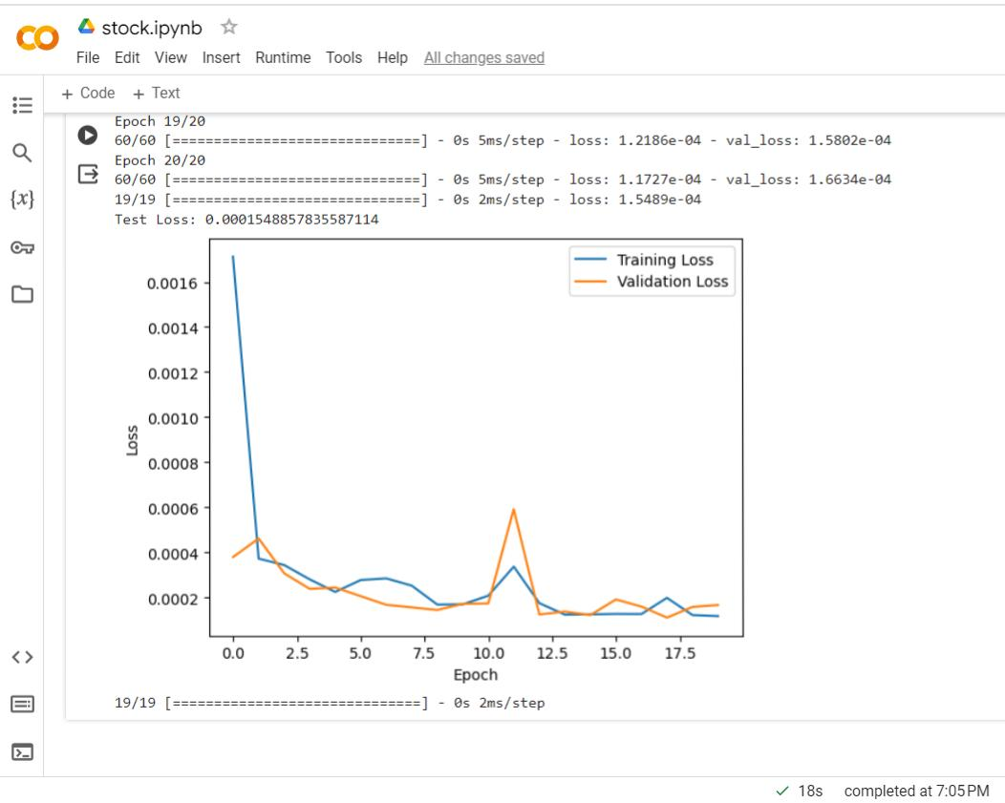
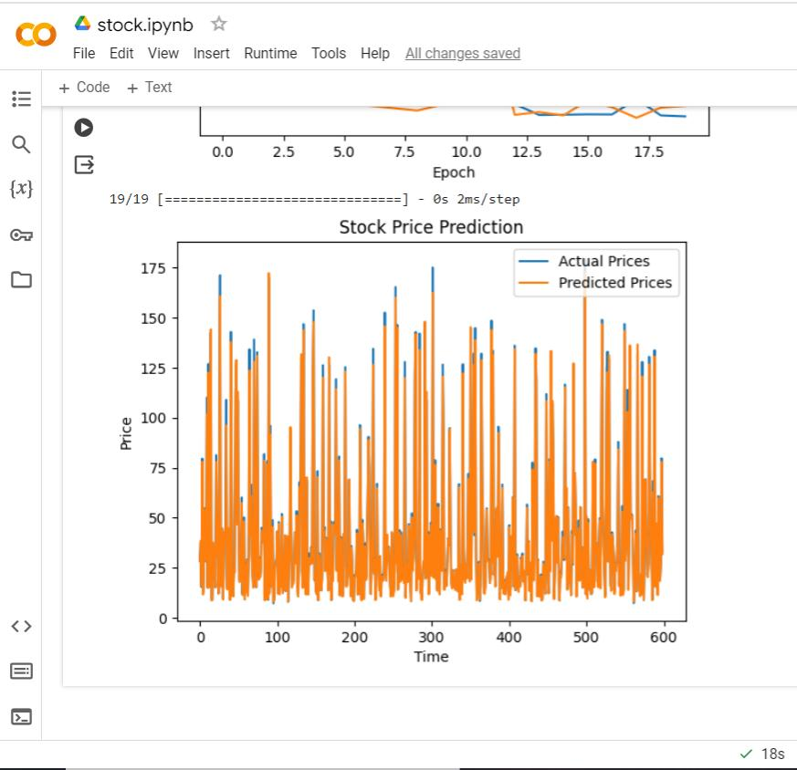
RESULTS
Demo Link
3/21/2024 Annual Review
10

Slide 11
THANK YOU

